Slide 1
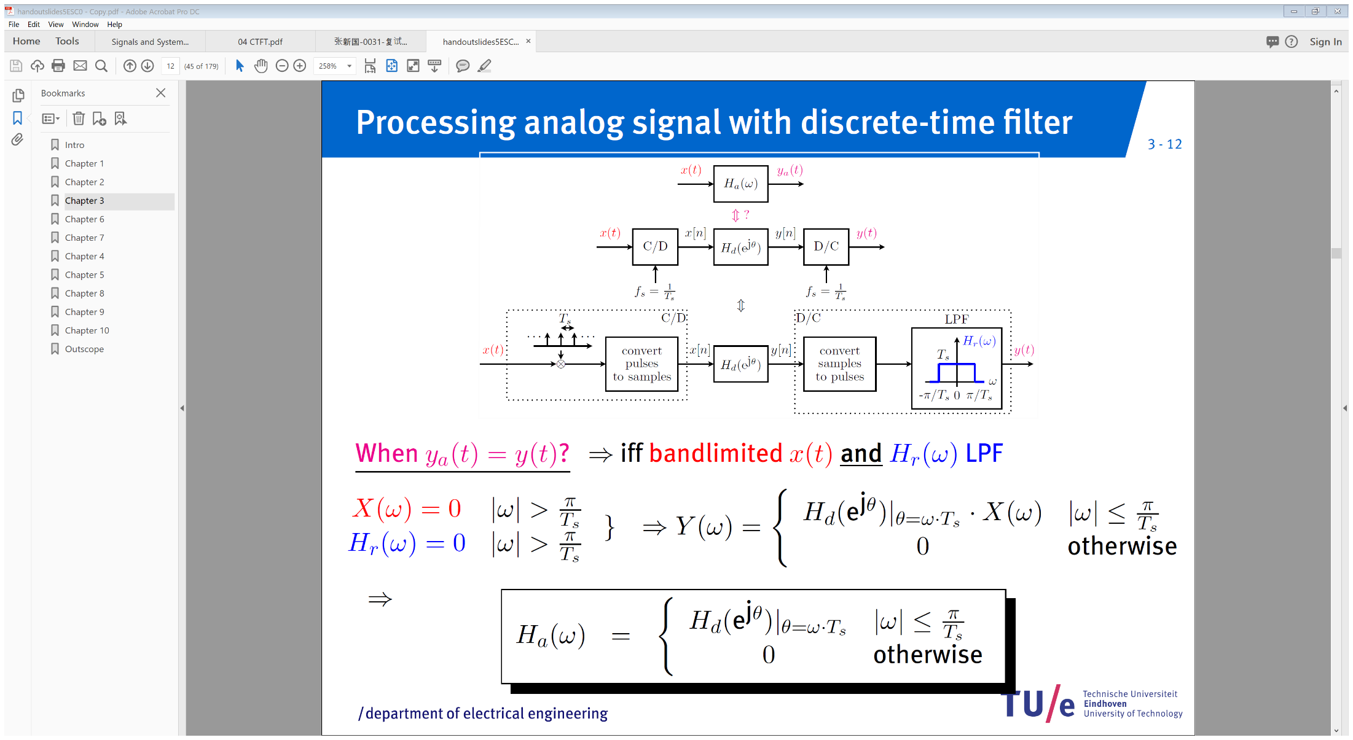
Processing analog signal with discrete-time filter

Slide 2
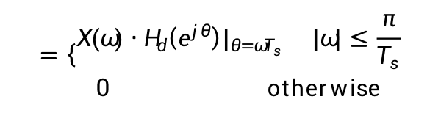
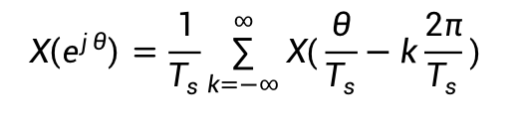
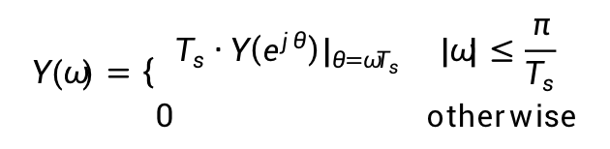

Processing analog signal with discrete-time filter
$$X\left(e^{jθ}\right)=\frac{1}{T_{s}}\sum_{k=−∞}^{∞}{X(\frac{θ}{T_{s}}−k\frac{2π}{T_{s}}) }$$
$$Y\left(e^{jθ}\right)=H_{d}\left(e^{jθ}\right)∙X\left(e^{jθ}\right)$$
$$Y(ω)=\left\{\begin{matrix}T_{s}∙Y\left(e^{jθ}\right)|_{θ=ωT_{s}} |ω|≤\frac{π}{T_{s}} \\ 0 otherwise\end{matrix}\right.$$
$$=\left\{\begin{matrix}{X(ω)∙H}_{d}\left(e^{jθ}\right)|_{θ=ωT_{s}} |ω|≤\frac{π}{T_{s}} \\ 0 otherwise\end{matrix}\right.$$

Slide 3
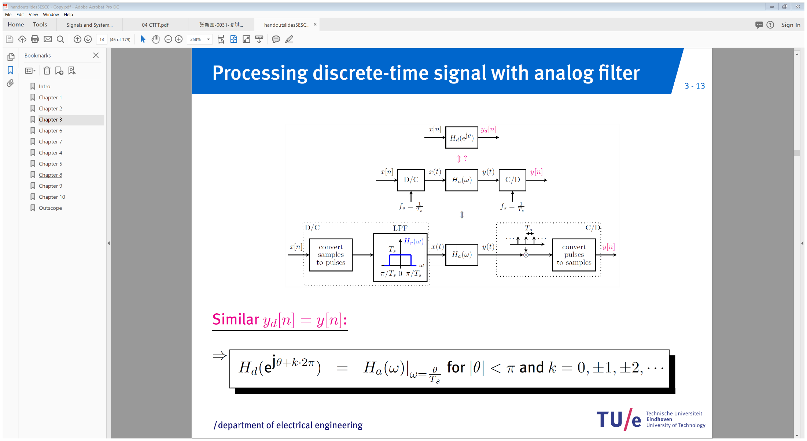
Processing discrete-time signal with analog filter

Slide 4
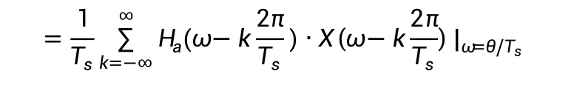
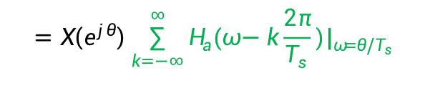
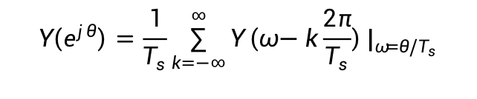

Processing discrete-time signal with analog filter
$$Y\left(ω\right)=H_{a}\left(ω\right)∙X\left(ω\right)$$
$$Y\left(e^{jθ}\right)=\frac{1}{T_{s}}\sum_{k=−∞}^{∞}{Y\left(ω−k\frac{2π}{T_{s}}\right)|_{ω=θ{/T}_{s}}}$$
$$=\frac{1}{T_{s}}\sum_{k=−∞}^{∞}{H_{a}(ω−k\frac{2π}{T_{s}})∙X\left(ω−k\frac{2π}{T_{s}}\right)|_{ω=θ/T_{s}} }$$
$$=X\left(e^{jθ}\right)\sum_{k=−∞}^{∞}{H_{a}(ω−k\frac{2π}{T_{s}})|_{ω=θ/T_{s}} }$$

Slide 5
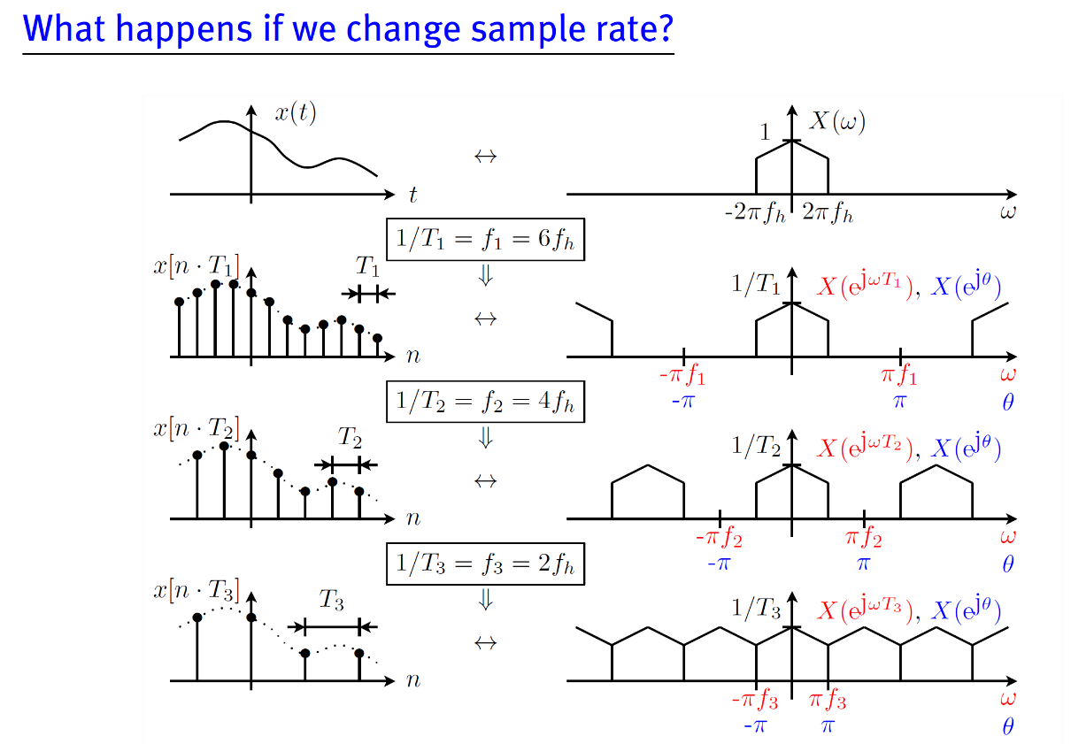
Sample rate conversion

Slide 6
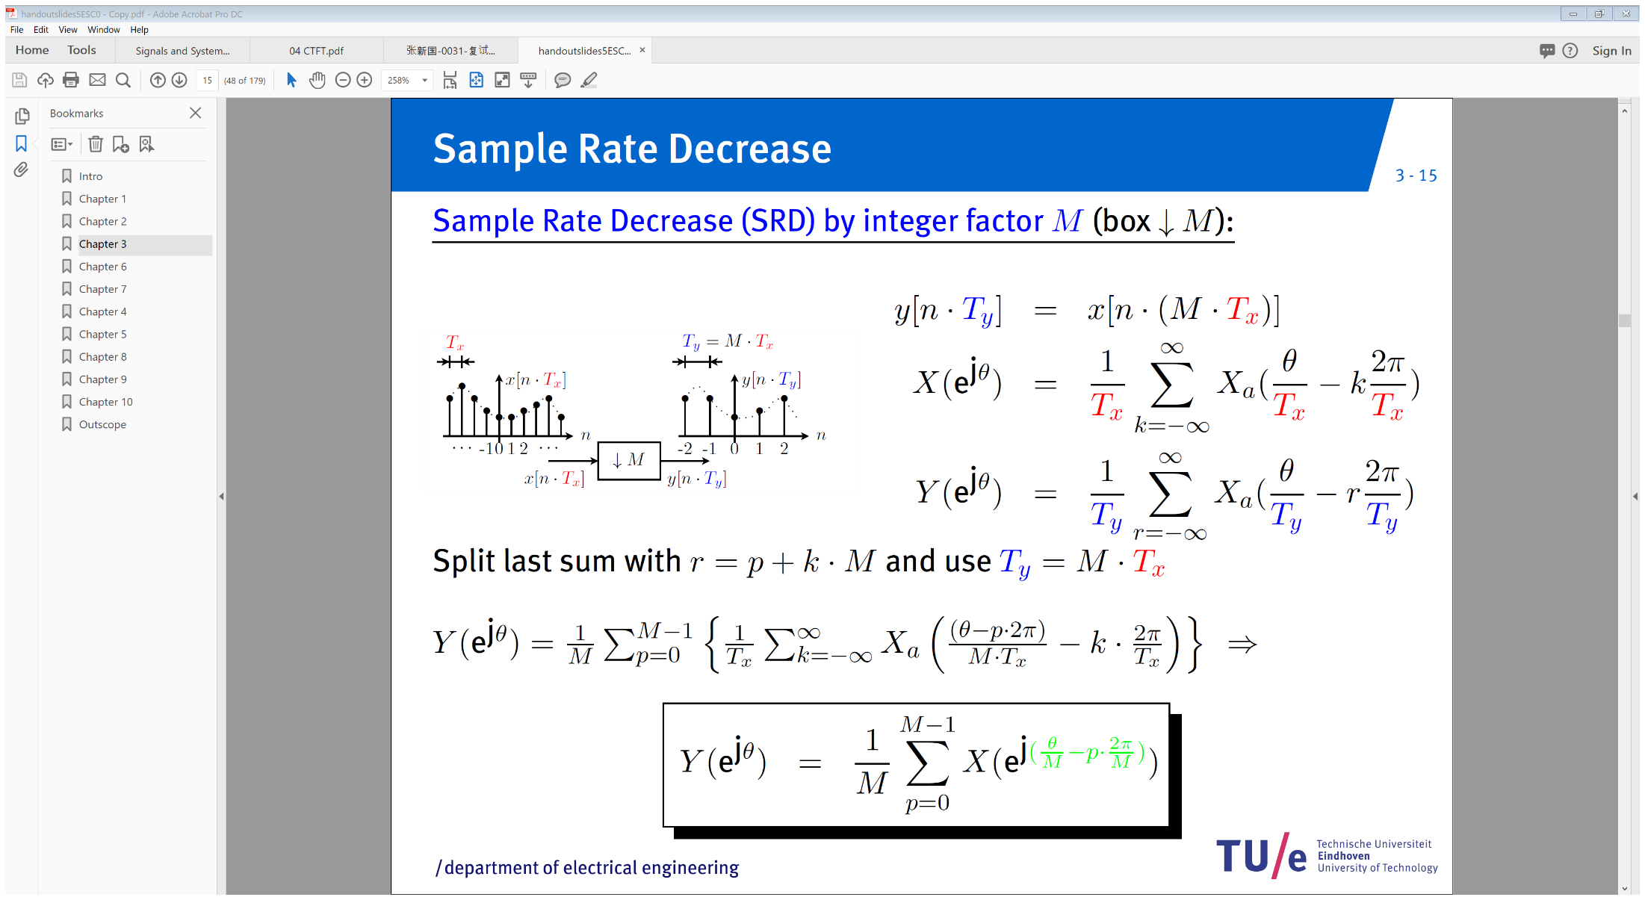
Sample Rate Decrease

Slide 7

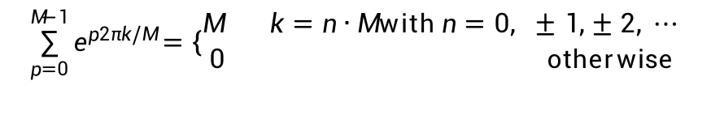
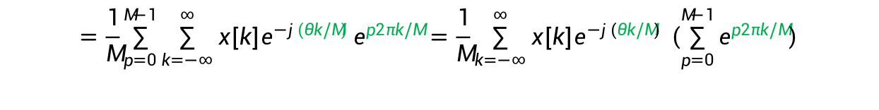
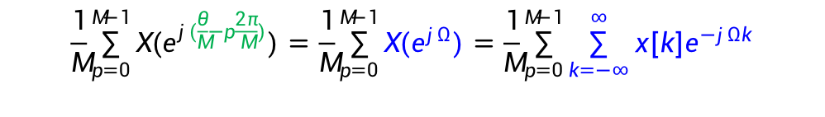
Sample Rate Decrease
$$\frac{1}{M}\sum_{p=0}^{M−1}{X(e^{j(\frac{θ}{M}−p\frac{2π}{M})})=\frac{1}{M}\sum_{p=0}^{M−1}{X(e^{jΩ})=\frac{1}{M}\sum_{p=0}^{M−1}{\sum_{k=−∞}^{∞}{x[k]e^{−jΩk}}}}}$$
$$Ω=(\frac{θ}{M}−p\frac{2π}{M})$$
$$=\frac{1}{M}\sum_{p=0}^{M−1}{\sum_{k=−∞}^{∞}{x[k]e^{−j(θk/M) }e^{p2πk/M}=\frac{1}{M}\sum_{k=−∞}^{∞}{x[k]e^{−j(θk/M) }\left(\sum_{p=0}^{M−1}{e^{p2πk/M}}\right)}}}$$
$$\sum_{p=0}^{M−1}{e^{p2πk/M}}=\left\{\begin{matrix}M k=n∙M with n=0, ±1,±2, ⋯ \\ 0 otherwise\end{matrix}\right.$$
$$=\sum_{k=n∙M, n=0, ±1, ±n, ⋯}{x[k]e^{−j(θk/M) }=\sum_{n=−∞}^{∞}{x[Mn]e^{−j(θn) }=\sum_{n=−∞}^{∞}{y\left[n\right]e^{−j\left(θn\right)}=Y{(e}^{jθ})}}}$$

Slide 8
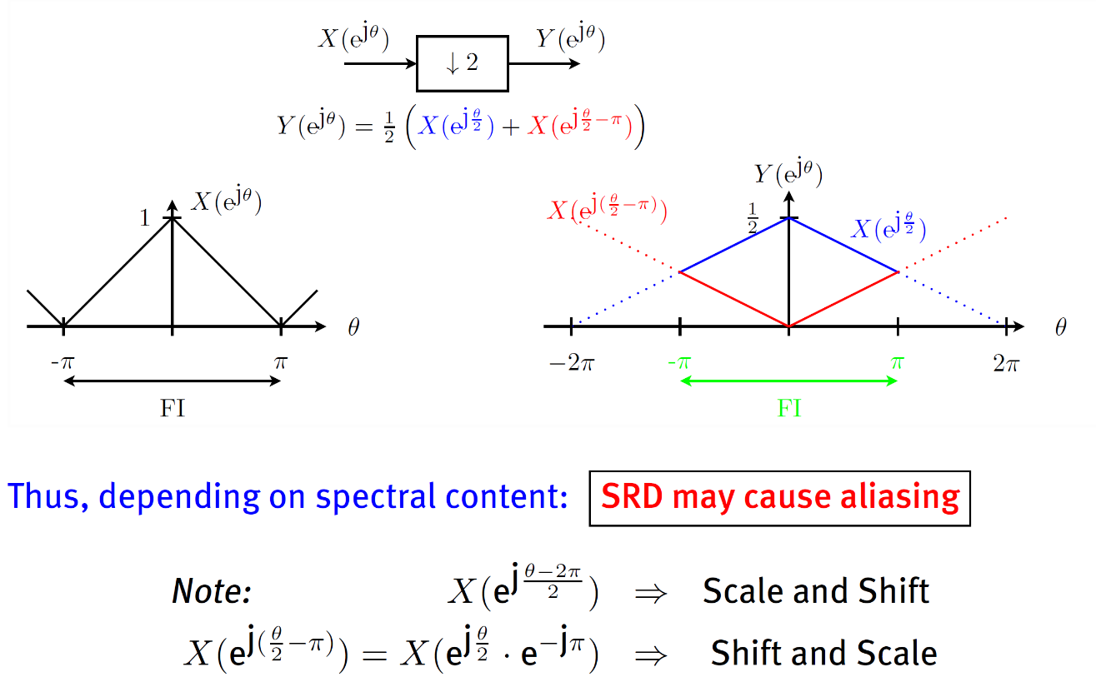
Sample Rate Decrease
Example factor 2 SRD

Slide 9
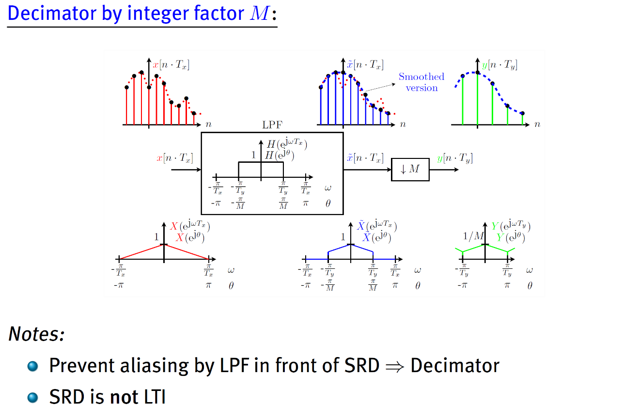
Sample Rate Decrease
Practice: Decimator

Slide 10
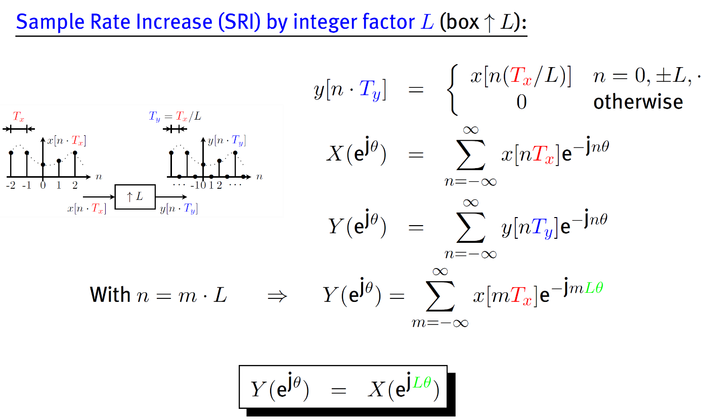
Sample Rate Increase

Slide 11
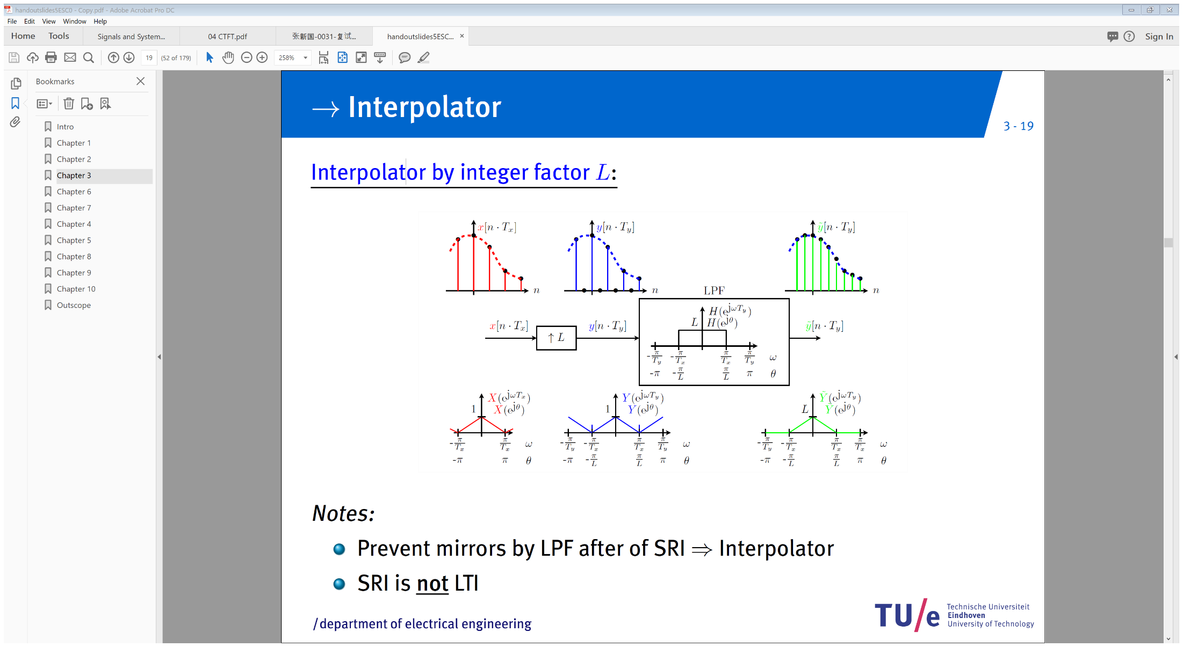
Sample Rate Increase

